Slide 1
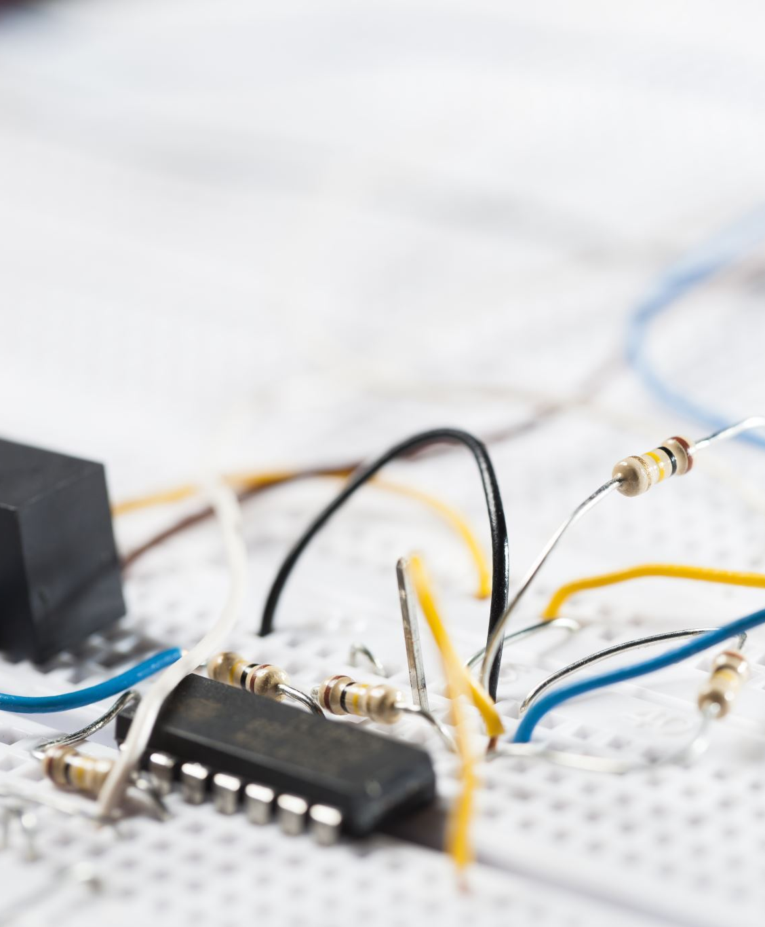
Electrical Engineering Music Box
Jih-Ching Chiu National Sun Yat-sen University Department of Electrical Engineering
MPD Laboratory

Slide 2
Circuit schematic diagram
Select song
Addr[7]
S[4..0]
Div[31..0]
Address
Generator
Memory
（Sheet music）
8bit*256
Memory
(Pitch)
32bit*32
Addr[7..0]
S[7..0]
reset
S[4:0]
Divider
(Sound
Frequency)
S[7..5]
Output
Addr[6..0]
S[4:0]
rst
m_clk
Output
Reset
end
Beat-
Divider
Table
BDN
Change
Count[5..0]
BDN[5..0]
Divider
(Beat Clock)
Asynchronous
Counter
Count
CMP(==)
Dff
Beat_clk
50MHz

Slide 3
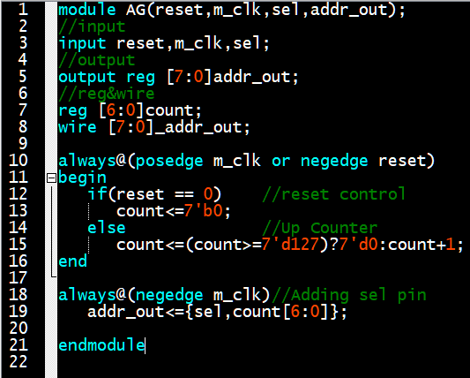
Adderess Generator
Select song
Addr[7]
Address
Generator
Addr[7..0]
Clock
Addr[6..0]

Slide 4
Beat frequency divider&Decoder
To represent most songs, we have divided them into 7 different note durations, including 1/32, 1/16, 1/8 notes, and so on. Therefore, in our design, we use 3 bits to represent these 7 different note durations.
Setting the shortest note, 1/32, to a value of 1, the 1/16 note to 2, and the 1/8 note to 4, and so on.
We've set the tempo of the music to 100 beats per minute (BPM). A 1/4 note is defined as one beat, one beat is equal to 6/10 seconds, which is equivalent to a frequency of 10/6 Hz.
The reference count of 1 for a 1/32 note is (1/8 * 6/10) seconds, which is equal to 80/6 Hz.

Slide 5
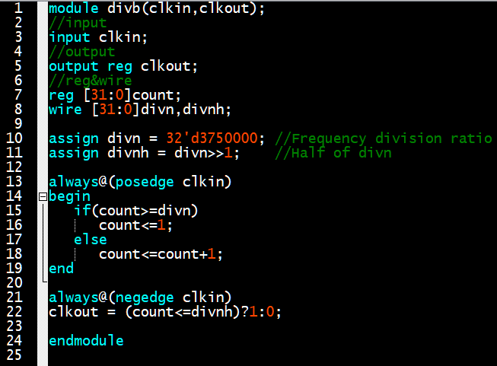
Beat frequency divider
Frequency divided by n means that one complete cycle is counted when reaching n.
So,when counting to n/2, the current state must be toggled.
Divider
(Beat)
Clock
Beat

Slide 6
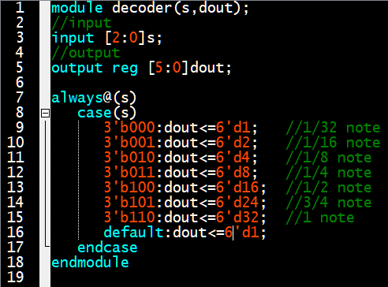
Decoder
note | Beat | Decoder Value
1/32 note | 1/8 beat | 1
1/16 note | 1/4 beat | 2
1/8 note | Half beat | 4
1/4 note | 1 beat | 8
1/2 note | 2 beat | 16
3/4 note | 3 beat | 24
1 note | 4 beat | 32
S[7..5]
Decoder
(Duration)
Durn

Slide 7
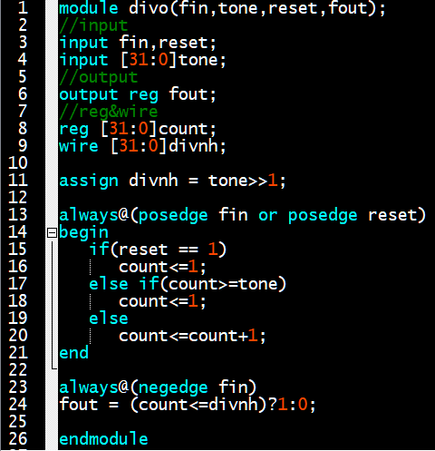
Audio frequency generation divider
The input tone is the division ratio retrieved from memory.
Div[31..0]
Divider
(Sound
Frequency)
Output
rst
Clock

Slide 8
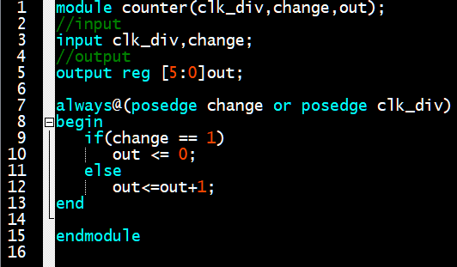
Beat Counter
Change
Count[5..0]
Counter
Count
Beat Clock

Slide 9
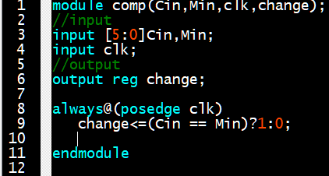
Beat comparator
Durn
Count
Mux
dff
Change
Beat Clock

Slide 10
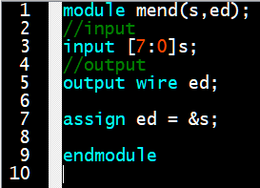
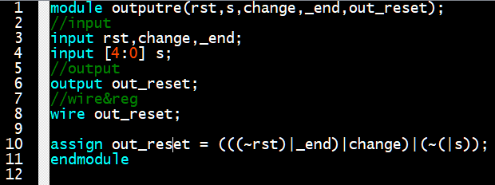
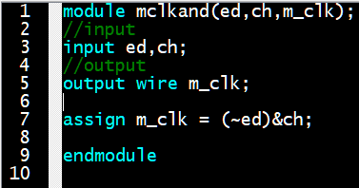
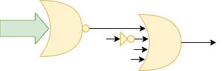
Output Reset & And Data
S[4...0]
reset
Out_reset
end
Change
S[7..0]
change
end
m_clk
end

Slide 11
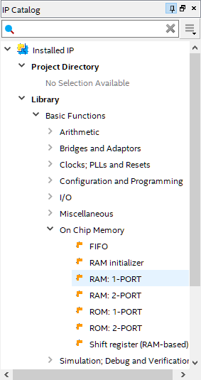
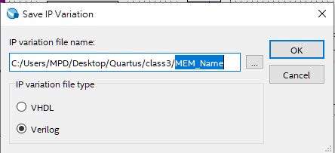
Memory creation
Step4
Step2:Enter name
Step3
step1

Slide 12
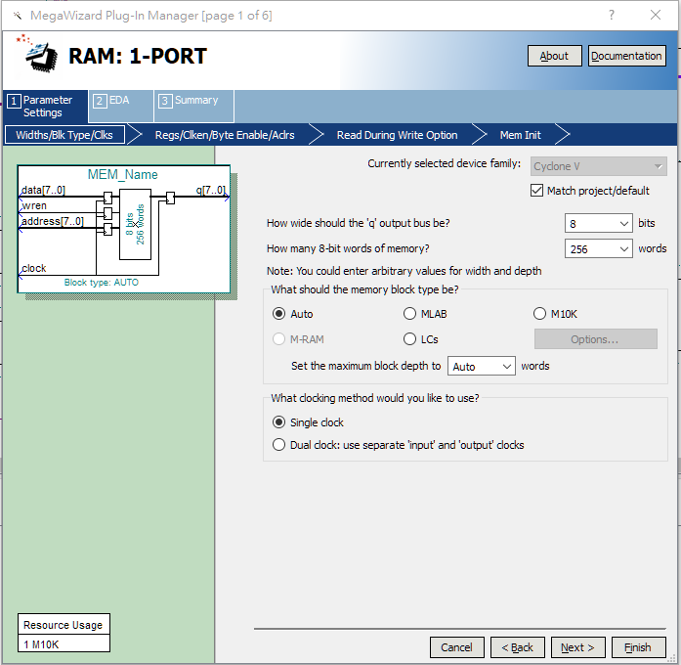
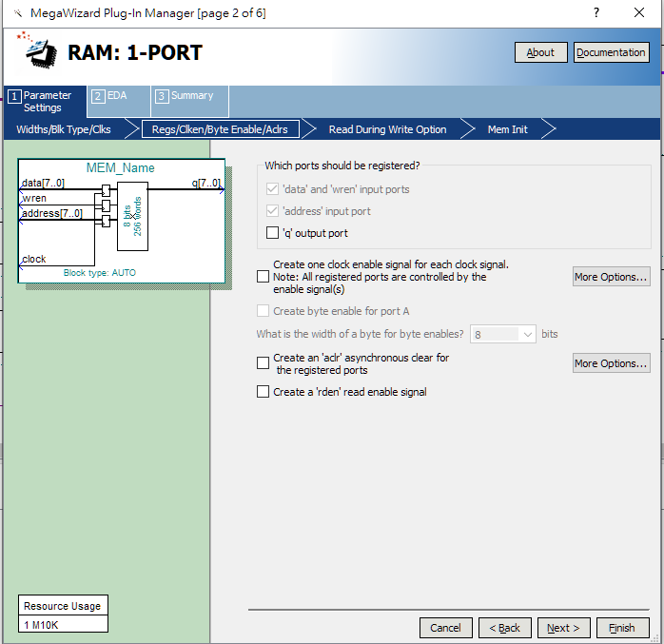
Memory creation
Step7
Step5
Step8
Step6

Slide 13
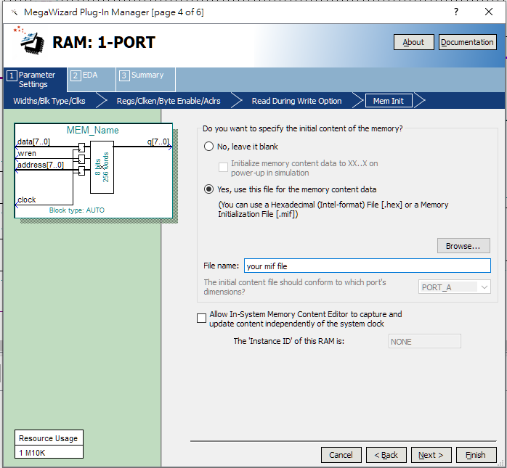
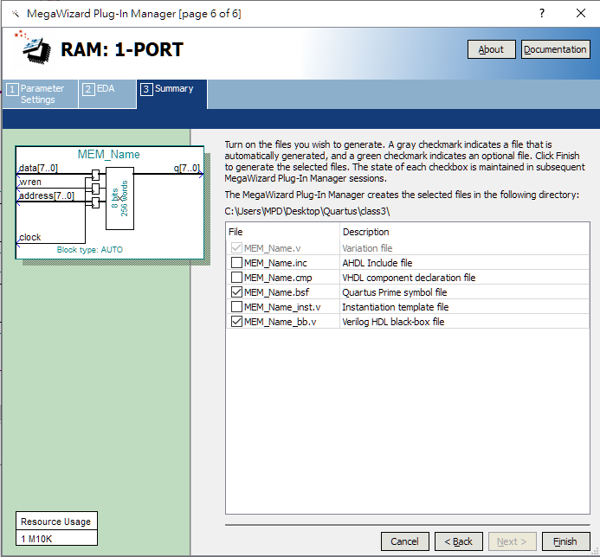
Memory creation
Step9
Step12
Step10
Step13
Step11
Step14

Slide 14
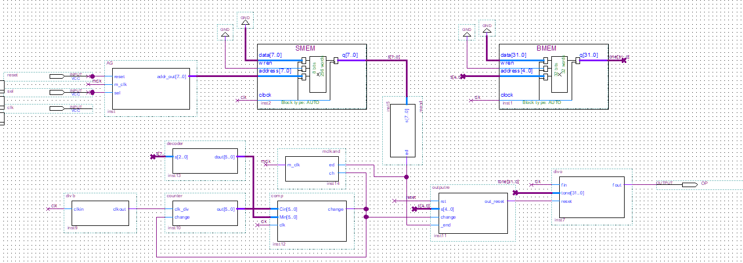
Wiring

